Slide 1
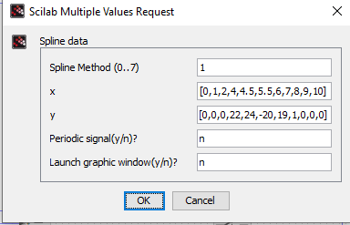












Steering angle changes while manoeuvre
Overtaking logic and math
Steering Wheel
Random test values as
signal builder
input for angles

Slide 2
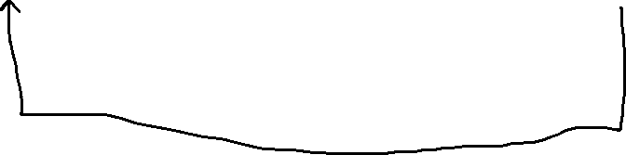

Start
Flowchart
TTC(Time to collision)<=3
Follows the ahead vehicle
Vc4<Vc1
Z > 5
(Y-X)>100
High Level Controller
Product of signals =1*1*1*=1
Actuates Steering Angle
Low Level Controller
Maneuver completed

